Slide 1
FALL DETECTION SYSTEM USING DEEPLEARNING
DEEPU.P - 97424607008
REVATHY R.K - 97424607013
SREELAKSHMI L- 97424607017
MSc C.S AI Department of Computer Science

Slide 2
AGENDA
Introduction
Problem Statement
Existing System
Proposed System
Dataset
Workflow
Dataflow
Hardware components
Software components
Circuit Diagram
Yolo v11 detection pipeline
Results
Advantages
Limitations
Applications
Future Enhancements
Conclusion
References

Slide 3
INTRODUCTION
Falls are one of the leading causes of injury among the elderly people
The aging population is rapidly increasing worldwide
Many older adults live alone without continuous supervision
Family members often have busy schedules and cannot monitor them constantly
Delayed medical assistance after a fall can lead to serious complications or even death
An automated fall detection system enables immediate alerts and faster response

Slide 4
Problem Statement
Current home security systems are passive. They record video, but they do not "understand" what is happening. If an elderly person falls the camera just watches it doesn't call for help. undetected for hours, it leads to serious injury or death.

Slide 5
Existing System
1. Manual Monitoring
Elderly individuals are monitored by family members or caregivers
Requires constant human presence
Not practical due to busy lifestyles
2. Wearable Devices
Devices like fall detection bands or smartwatches (e.g., Apple Watch)
Detect falls using motion sensors (accelerometer, gyroscope)
Limitations:
Must be worn at all times
Can be forgotten or removed
False alarms possible
3. Camera-Based Systems (Traditional)
Use CCTV cameras with basic motion detection
Limited intelligence and accuracy
Cannot reliably distinguish falls from normal activities

Slide 6
Limitations of Existing Systems
Lack of real-time intelligent detection
High false positives or missed detections
Dependence on user compliance (wearables)
Expensive or complex setups

Slide 7
Proposed System
This project uses YOLO11 and a Low-Cost Camera (ESP32) to create a system that sees the fall, analyzes the situation instantly without human help and trigger buzzer and send Alerts to caregiver via Telegram only when a fall is detected.

Slide 8
Dataset Used
UR-fall-detection-dataset aggregating 11936 images it contains 2995 fall image and 8941 non fall
Class Index Mapping
Class 0: Violence
Class 1: fall
Class 2: sit
Class 5: standing
Training : 80% , Test :10% ,Val :10%

Slide 9

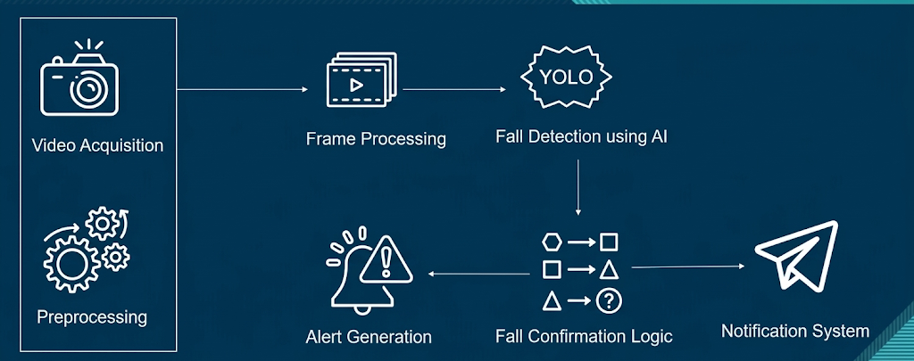



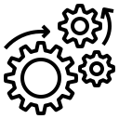


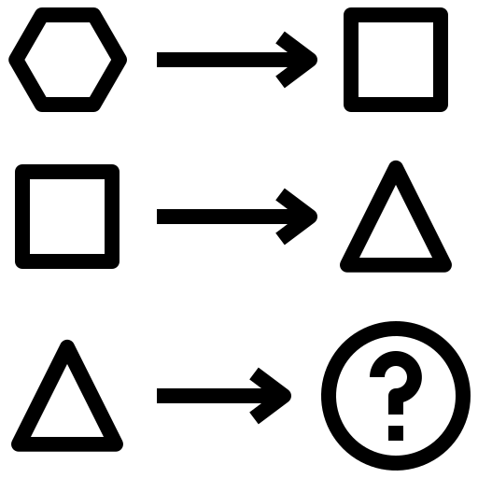
Workflow
Video Acquisition
Frame Processing
Fall Detection using AI
Preprocessing
Alert Generation
Fall Confirmation Logic
Notification System

Slide 10
workflow
Step 1: Video Capture
The ESP32-CAM / system camera captures real-time video of the monitored environment
Step 2: Preprocessing
The ESP32-CAM's internal hardware (the OV2640 sensor) takes the raw data and compresses it into a JPEG.
Captured high resolution frames are scales down to 320x240 pixels.
Image Normalization
Step 3: Frame Processing
Video stream is divided into individual frames
Frames are passed to the detection system for analysis
Step 4: Fall Detection using AI
Each frame is processed using a YOLO model
The model detects human posture and identifies potential fall events

Slide 11
Contd…
Step 5: Fall Confirmation Logic
A fall is not immediately confirmed
The system checks if the fall condition persists for 5 seconds
This reduces false positives
Step 6: Alert Generation
Once a fall is confirmed:
Buzzer triggered
Image of the frame is captured
Step 7: Notification System
Alert is sent via Telegram
Caregivers receive:
Warning message
Captured image
Step 8: Continuous Monitoring
System continues monitoring in real-time
Cooldown mechanism prevents repeated alerts

Slide 12
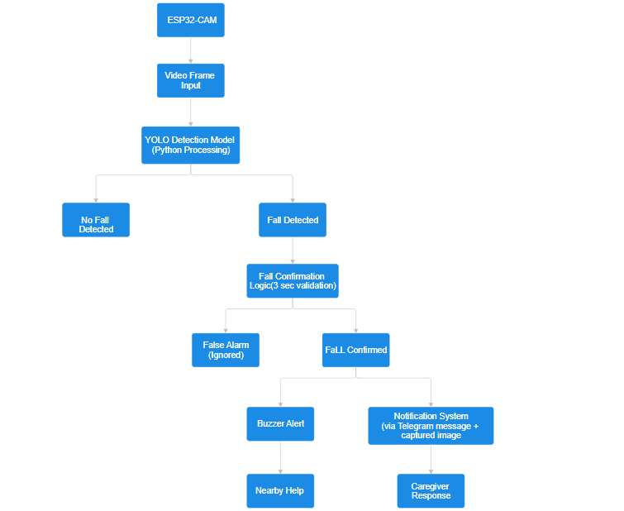
Data Flow

Slide 13
Hardware Components
Camera – Captures real-time video for monitoring
ESP32 – Handles IoT communication and alert triggering
Buzzer – Generates an audible alert during fall detection
Power Supply – Supplies power to the system
Wi-Fi Module (built-in ESP32) – Enables internet connectivity
FTDI – for programming the esp32 cam

Slide 14
Software Components
Python – Used for system development
OpenCV – Handles image and video processing
Ultralytics YOLO – Detects human posture and fall events
VS Code – Development environment
Dataset (Roboflow / Open Images) – Used for training the model

Slide 15
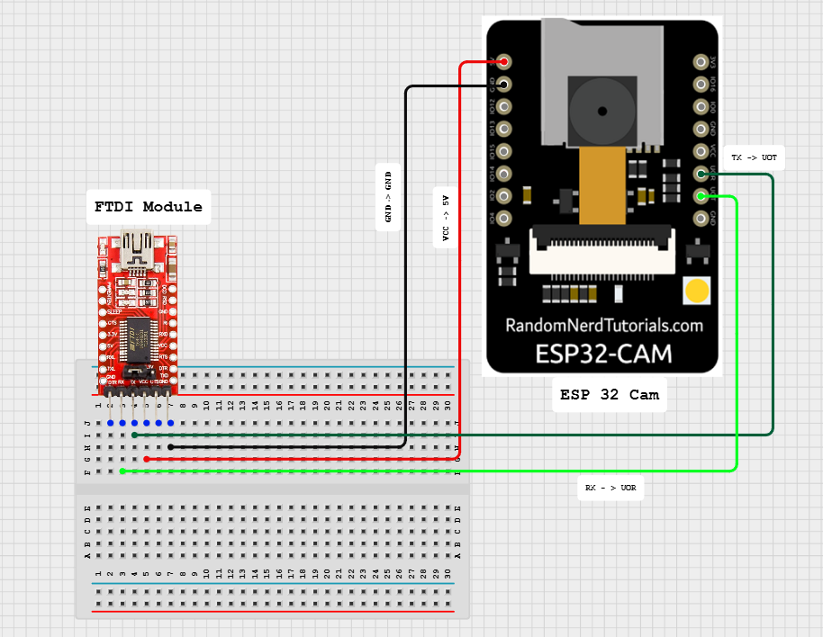
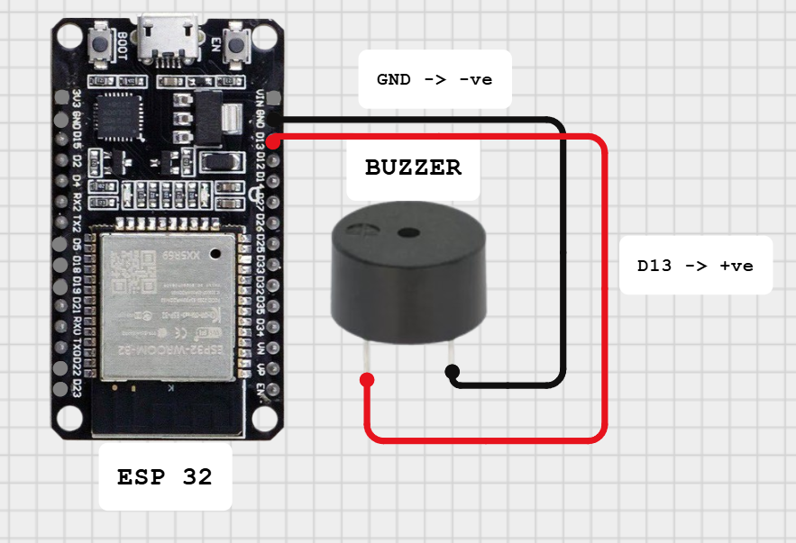
Circuit Diagram
Cam module
Buzzer module

Slide 16
The YOLO11 Detection Pipeline
1. Input & Data Preprocessing
The algorithm begins by preparing the raw frame from the ESP32-CAM for the neural network.
Letterboxing: Resizes the image to a fixed square while preserving the aspect ratio using padding.
Normalization: Converts pixel values from RGB (0–255) to a floating-point range (0.0–1.0) to stabilize the mathematical gradients.
2. Feature Extraction (Backbone)
This is the "brain" of the model that identifies patterns.
C3k2 Blocks: Uses "Cross-Stage Partial" bottlenecks with smaller kernels to extract deep features (edges, textures, human shapes) more efficiently than previous versions.
C2PSA (Position-Sensitive Attention): A new attention mechanism that helps the model distinguish the human subject from complex backgrounds like furniture or patterned rugs.
3. Feature Fusion (Neck)
PANet (Path Aggregation Network): Combines "low-level" spatial features (where things are) with "high-level" semantic features (what things are).
This ensures the model can accurately detect a person even if they are partially occluded or far from the camera.

Slide 17
The YOLO11 Detection Pipeline
4. Prediction & Regression (Head)
YOLO11 uses a Decoupled Task-Aligned Head to perform three simultaneous tasks:
Classification: Determines the probability that the object is a "Person."
Bounding Box Regression: Predicts the precise coordinates $(x, y, w, h)$.
Keypoint Estimation: (If using YOLO11-Pose) Tracks 17 skeletal joints to analyze body posture.
5. Post-Processing & Output
Confidence Thresholding: Filters out "weak" detections with low probability scores.
NMS (Non-Maximum Suppression): Eliminates overlapping redundant boxes, leaving only one high-accuracy detection per person.
Final Output: Provides the coordinates used by your app to calculate if a fall has occurred.

Slide 18
Executive Summary
Metric | Value
Recall (Sensitivity) | 86.3%
Precision | 78.2%
mAP@50 | 81.9%
Fitness Score | 0.687

Slide 19
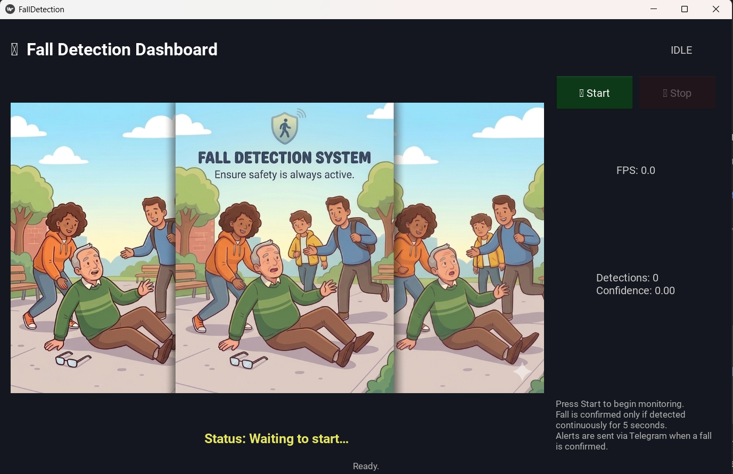
Results

Slide 20
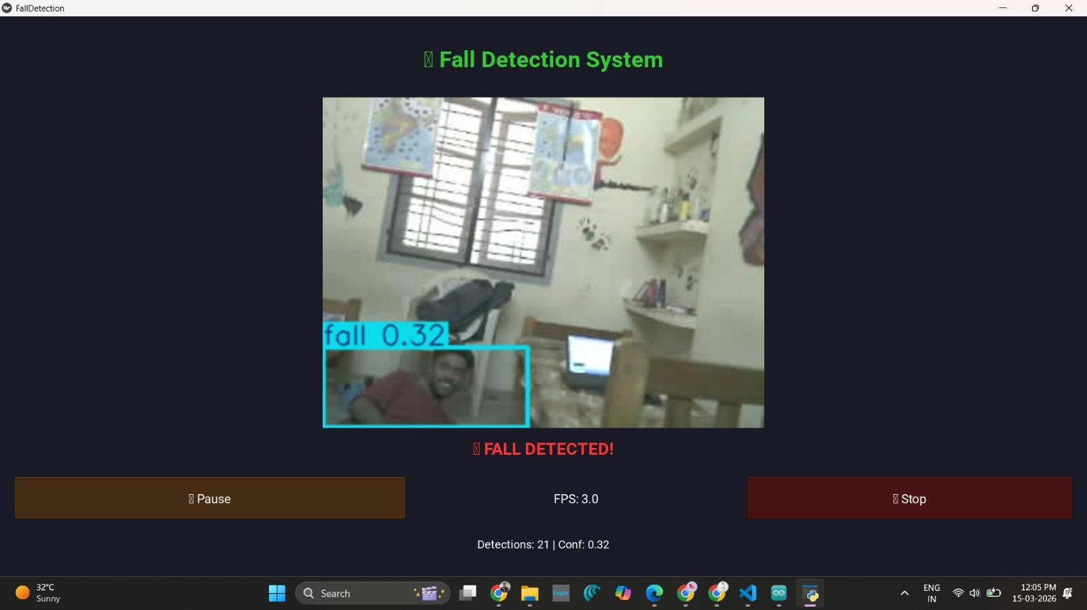
Results

Slide 21
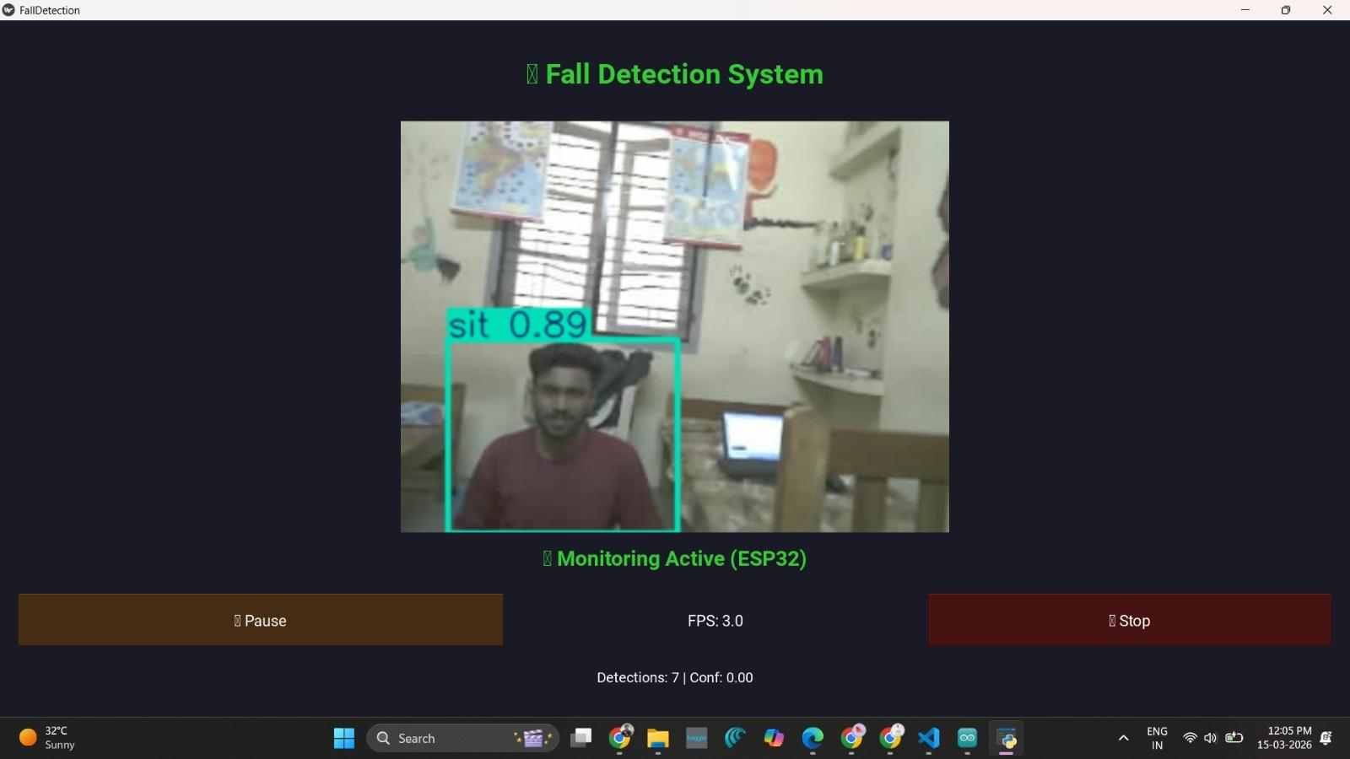
Results

Slide 22
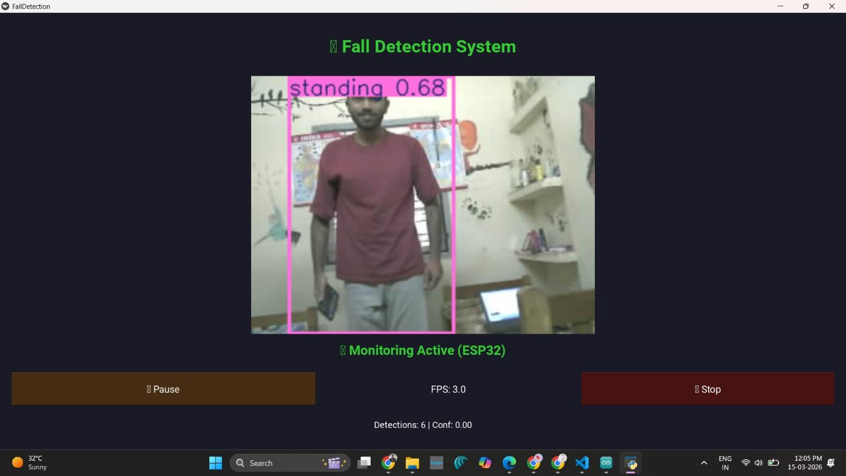
Results

Slide 23
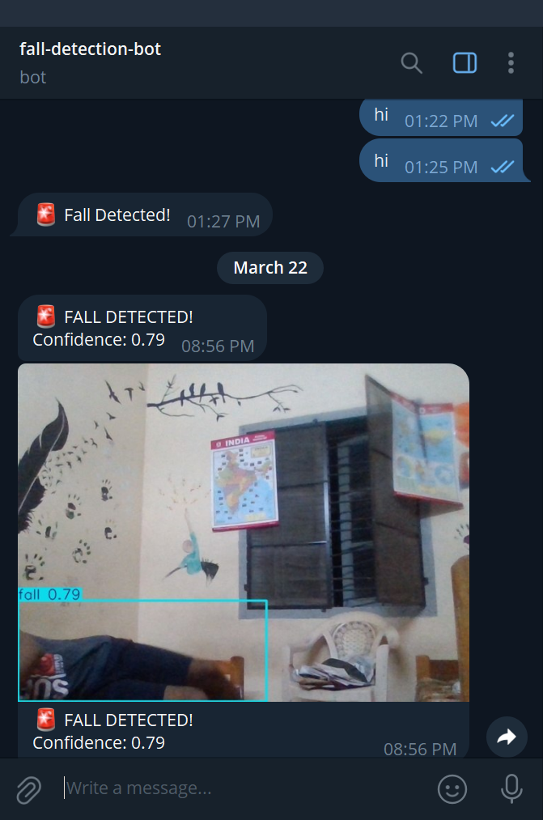
Results

Slide 24
Advantages
Real-Time Fall Detection: Detects falls instantly and reduces response time
High Accuracy: Uses AI models like Ultralytics YOLO for reliable detection
No User Interaction Required: Fully automated system without manual input
Continuous Monitoring: Works 24/7 using camera-based surveillance
Immediate Alert System: Sends alerts quickly through ESP32
Cost-Effective Solution: Uses affordable hardware components
Improves Safety: Helps elderly and patients get timely assistance

Slide 25
Limitations
Lighting Dependency: Camera-based detection may not work well in low-light or night conditions
False Positives / Negatives: The system using Ultralytics YOLO may sometimes misclassify activities
(e.g., sitting vs falling)
Camera Coverage Limitation: Falls outside the camera’s field of view cannot be detected
Internet Dependency: IoT alerts via ESP32 require stable Wi-Fi connection
Privacy Concerns: Continuous video monitoring may raise privacy issues
Hardware Constraints: Limited processing power of IoT devices may affect performance

Slide 26
Applications
Elderly Care Homes: Monitors senior citizens and provides immediate assistance during falls
Hospitals and Healthcare Centers: Helps in continuous patient monitoring and emergency response
Smart Homes: Enhances safety by integrating with home automation systems
Rehabilitation Centers: Tracks patient movements during recovery and therapy
Assisted Living Facilitie: Supports individuals with disabilities or mobility issues
Home Care for Patients: Useful for people living alone who need constant monitoring

Slide 27
Future Enhancements
Mobile Application Integration: Develop a mobile app for real-time alerts and monitoring
Night Vision Capability: Improve performance in low-light conditions using infrared cameras
Voice Alert System: Add audio alerts or emergency voice assistance
GPS Tracking: Track the location of the person during emergencies
Cloud Integration: Store data and alerts on cloud platforms for remote access
Improved AI Accuracy: Enhance detection using advanced models beyond Ultralytics YOLO
Wearable + Vision Hybrid System: Combine sensors with camera-based detection for better reliability

Slide 28
Conclusion
The proposed IoT-based fall detection system provides an effective solution for monitoring and ensuring the safety of elderly individuals and patients. By integrating Artificial Intelligence and IoT technologies, the system is capable of detecting falls in real time and generating immediate alerts.
The use of advanced models like Ultralytics YOLO improves the accuracy of detection, while IoT modules such as ESP32 enable fast communication and alert delivery.
Overall, the system reduces response time during emergencies, minimizes risks, and enhances independent living. This project demonstrates how smart technologies can be applied in healthcare to create safer and more reliable monitoring systems

Slide 29
References
Ultralytics YOLO Documentation https://docs.ultralytics.com
OpenCV Documentation https://opencv.org
Roboflow https://roboflow.com
Open Images Dataset https://storage.googleapis.com/openimages/web/index.html

Slide 30
Thank You

